Slide 1













Slide 2
Answer here
https://www.youtube.com/watch?v=8m6hHRlKwxY&vl=en
Answer here
Answer here
Is your work saved?
Go Back to Lab Room

Slide 3
Type/draw here.
Type/draw here.
Type/draw here.
Continue to Part 2

Slide 4
Type/draw here.
Type/draw here.
Continue to Questions

Slide 5
Answer here
Answer here
Answer here
Is your work saved?
Go Back to Lab Room

Slide 6
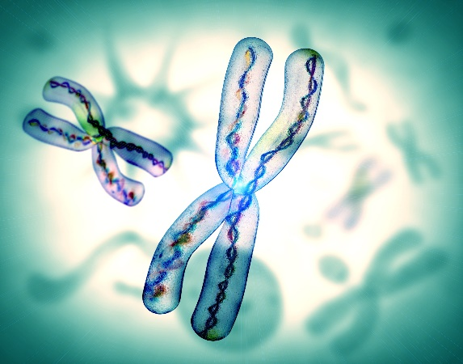
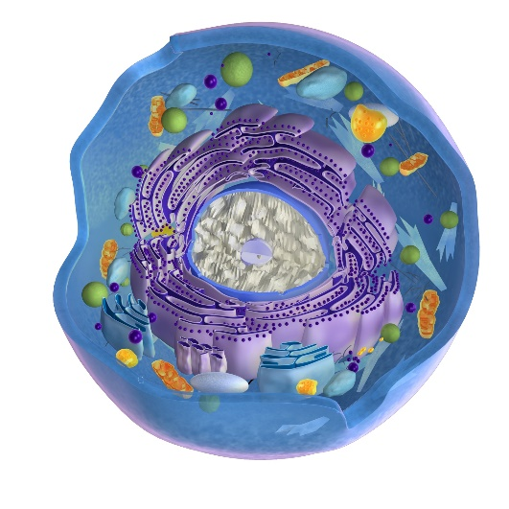
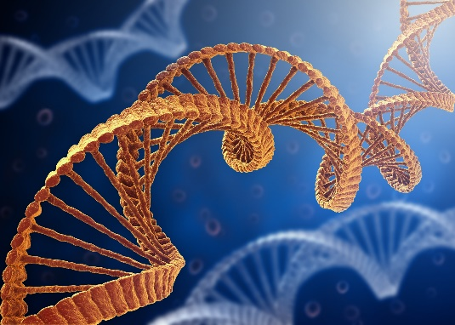
Answer here
Genes
Chromosomes
Nucleus
DNA
Go to Part 2

Slide 7
Answer here
Chromosomes – Thread-like structures that are found in the nucleus of a cell that contains all DNA.
Nucleus – stores the cells hereditary material or DNA
DNA – molecule that carries the genetic instructions for all living organisms. Found in the chromosome.
Genes – parts of the DNA which control the traits of an organism
Go to Part 3

Slide 8
Answer here

Slide 9
Answer here
https://learn.genetics.utah.edu/content/basics/
Answer here
Answer here
Answer here
Answer here
Is your work saved?
Go Back to Lab Room

Slide 10
Is your work saved?
Go Back to Lab Room

Slide 11
Go to Image Help

Slide 12
Is your work saved?
Go Back to Lab Room

Slide 13
Answer here
Go to Question 2

Slide 14
Answer here
Go to Question 3

Slide 15
Answer here
Is your work saved?
Go Back to Lab Room

Slide 16
Answer here
Answer here
Answer here
Is your work saved?
Go Back to Lab Room

Slide 17
Answer here
Answer here
Answer here
Answer here
Answer here

Slide 18
INTERVIEW
RESEARCH
MAKE A MODEL
ACROSTIC

Slide 19
Is your work saved?
Go Back to Challenges
or
Go Back to Lab Room

Slide 20
Is your work saved?
Go Back to Challenges
or
Go Back to Lab Room

Slide 21
Is your work saved?
Go Back to Challenges
or
Go Back to Lab Room

Slide 22
Is your work saved?
Go Back to Challenges
or
Go Back to Lab Room

